Slide 1
Embedded Picture Mnemonic Grids
Why is identifying a first sound important?
The ability to isolate the first sound in a word is highly related to later reading acquisition and reading achievement.
Why use embedded picture mnemonics?
Embedded picture mnemonics are a research-based way to teach children about letters and the sounds they represent. They are letter cards with a picture of a key word embedded directly in a letter, such as the letter z made out of a zipper, or the letter r made out of a road. Research indicates that students learn letter-sound correspondences better when they are taught with embedded picture mnemonics (Ehri et al., 1984).
Possible ways to use your UFLI-aligned grids
Roll and Read
Three in a row
Connect 4 style
Answer Key:
a - apple, b - banana, c - cat, d – dinosaur, e – echo, f – fish, g – goose, h – horse, i – itch, j – jelly beans, k – keys, l – leaf, m – mittens, n – net, o – octopus, p – pumpkin, qu – quarter, r – road, s – sandwich, t – tiger, u – umbrella, v – volcano, w – worm, x – box, y – yoyo, z - zipper

Slide 2
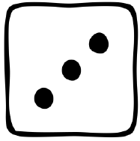
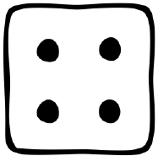
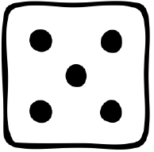
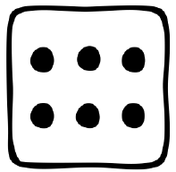
Notes:
Begin after first 3 lessons

Slide 3
Notes:
New – t Review - sma

Slide 4
Notes:
New – p New Review – t Old Review - sma

Slide 5
Notes:
New – f New Review – p Old Review - tsma

Slide 6
Notes:
New – i New Review – f Old Review - ptsma

Slide 7
Notes:
New – n New Review – i Old Review - fptsma

Slide 8
Notes:
New – o New Review – n Old Review - ifptsma

Slide 9
Notes:
New – d New Review – o Old Review -nifptsma

Slide 10
Notes:
New – c New Review – d Old Review -onifptsma

Slide 11
Notes:
New – u New Review – c Old Review -donifptsma

Slide 12
Notes:
New – g New Review – u Old Review -cdonifptsma

Slide 13
Notes:
New – b New Review – g Old Review -ucdonifptsma

Slide 14
Notes:
New – e New Review – b Old Review -gucdonifptsma

Slide 15
Notes:
New – k New Review – e Old Review -bgucdonifptsma

Slide 16
Notes:
New – h New Review – k Old Review -ebgucdonifptsma

Slide 17
Notes:
New – r New Review – h Old Review -kebgucdonifptsma

Slide 18
Notes:
New – l New Review – r Old Review -hkebgucdonifptsma

Slide 19
Notes:
New – w New Review – l Old Review -rhkebgucdonifptsma

Slide 20
Notes:
New – j New Review – w Old Review -lrhkebgucdonifptsma

Slide 21
Notes:
New – y New Review – j Old Review -wlrhkebgucdonifptsma

Slide 22
Notes:
New – x New Review – y Old Review -jwlrhkebgucdonifptsma

Slide 23
Notes:
New – qu New Review – x Old Review -yjwlrhkebgucdonifptsma

Slide 24
Notes:
New – v New Review – qu Old Review -xyjwlrhkebgucdonifptsma

Slide 25
Notes:
New – z New Review – v Old Review -quxyjwlrhkebgucdonifptsma

Slide 26
Notes:
Review 1st 6 letters - fptsma

Slide 27
Notes:
Review 2nd group of 6 letters (inodcu) with Review of 1st set (amstpf)

Slide 28
Notes:
Review 3rd group of 6 letters (gbekhr) with Review of 2nd set (inodcu)

Slide 29
Notes:
Review remaining letters (lwjyxquvz) Old review of 3rd set (gbekhr)

Slide 30
Notes:
All Letters, extra spaces given to commonly confused letters: vowels, b/d, p/qu, y

